Slide 1
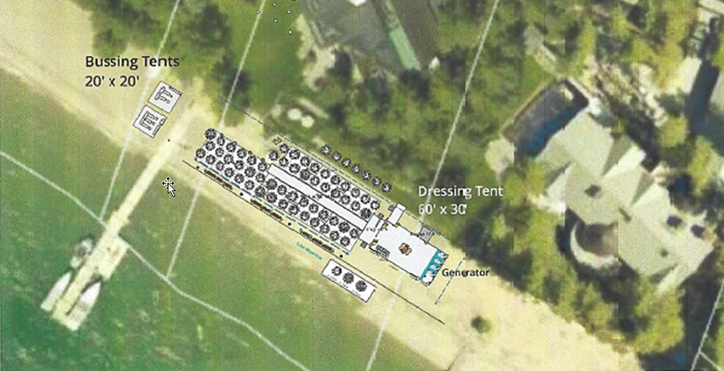
WADMIN19-0013
League to Save Lake Tahoe Annual Fashion Show and Luncheon, Outdoor Community Event
Washoe County Board of Adjustment
July 11, 2019

Slide 2
Overview
One-day outdoor community event
650 participants and 225 staff
LDS – 1 unit per acre
Luncheon and fashion show
1047 Lakeshore Boulevard

Slide 3
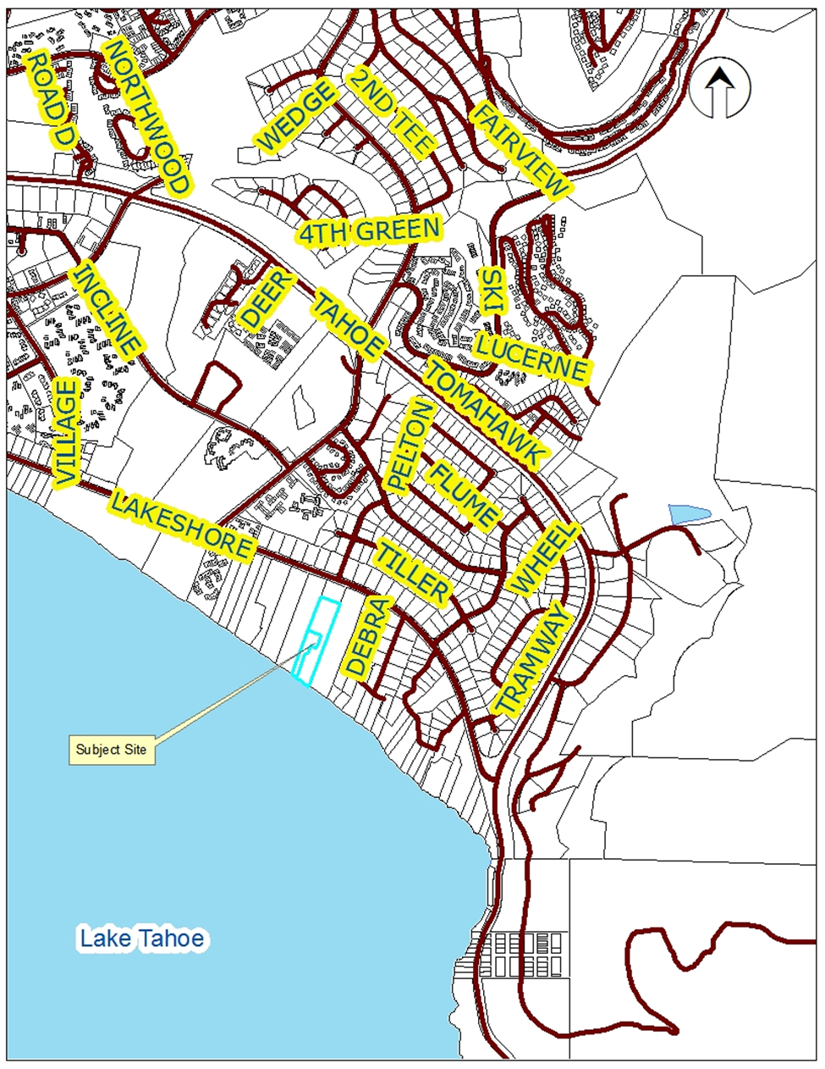
Location

Slide 4
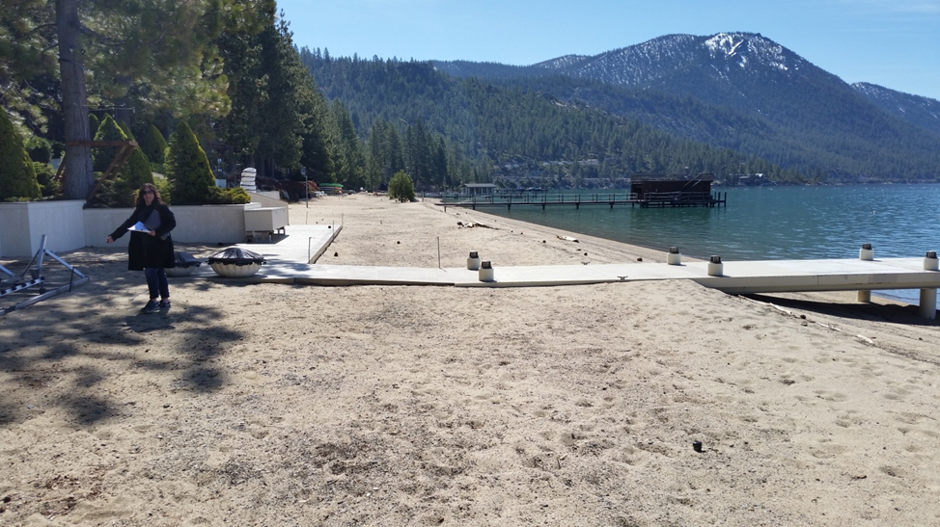
Location

Slide 5
Evaluation
Contracts provided for:
  Security services
  Fire and Emergency Medical Services
  Sanitary facilities
  Trash removal
Liability insurance provided
All parking at Sierra Nevada College
Amplified sound
Set-up and tear-down from 8 a.m. to 7 p.m. only

Slide 6
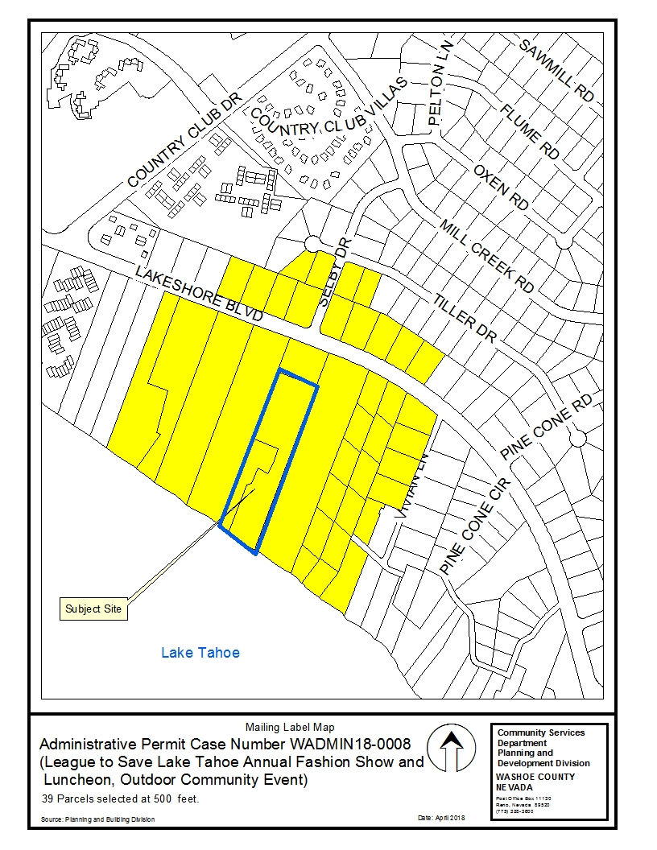
Public Notice & CAB
Notice sent to owners of 56 parcels within 500 feet
Incline Village/Crystal Bay CAB, June 3, 2019 – recommended approval

Slide 7
Reviewing Agencies
Shown on pages 8 and 9 of the staff report
Recommended conditions of approval have been included
No recommendations for denial were received

Slide 8
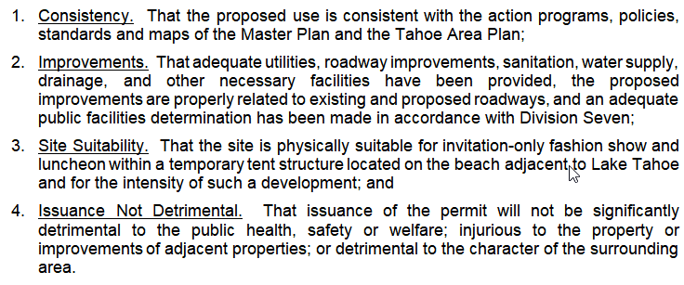
Administrative Permit Findings
Staff comments on each finding are included at page 8 of the staff report

Slide 9
Amended Condition
Condition 2a:
On page A-14 of the permit application, in the document titled, “Agreement between the League to Save Lake Tahoe and Sierra Nevada College for August 3, 2019”, the third paragraph states, “SNC will allow The League to use their parking lot and parking facility on Saturday, August 4, 2019 to allow for guests, volunteers, staff and vendors to park for a nearby event.” A corrected Agreement shall be provided to Engineering and Capital Projects for review and approval 30 days prior to the event immediately upon approval of this Administrative Permit, showing Saturday, August 3, 2109 as the day to allow use of the parking lot and facility at SNC.

Slide 10
Possible Motion
I move that, after giving reasoned consideration to the information contained in the staff report and information received during the public hearing, the Board of Adjustment approve Administrative Permit Case Number WADMIN18-0008 for League to Save Lake Tahoe, and an Outdoor Community Event business license application and associated license conditions, as amended, for the League to Save Lake Tahoe Annual Fashion Show and Luncheon, having made the four findings in accordance with Washoe County Development Code Section 110.808.25, I further move to authorize the Director of the Planning and Building Division to issue the business license when all pre-event conditions have been satisfied.

